Slide 1

CAN MONEY BUY HAPPINESS?
Janda Hejhal
WEALTH AND SECURITY
STATISTICS
CONSUMER CULTURE
OVERWORKING
MONEY IS NOT ENOUGH
CONCLUSION

Slide 2

CAN MONEY BUY HAPPINESS?
Janda Hejhal
WEALTH AND SECURITY
STATISTICS
CONSUMER CULTURE
OVERWORKING
MONEY IS NOT ENOUGH
CONCLUSION

Slide 3

CAN MONEY BUY HAPPINESS?
Janda Hejhal
WEALTH AND SECURITY
STATISTICS
CONSUMER CULTURE
OVERWORKING
MONEY IS NOT ENOUGH
CONCLUSION

Slide 4

CAN MONEY BUY HAPPINESS?
Janda Hejhal
WEALTH AND SECURITY
STATISTICS
CONSUMER CULTURE
OVERWORKING
MONEY IS NOT ENOUGH
CONCLUSION

Slide 5

CAN MONEY BUY HAPPINESS?
Janda Hejhal
WEALTH AND SECURITY
STATISTICS
CONSUMER CULTURE
OVERWORKING
MONEY IS NOT ENOUGH
CONCLUSION

Slide 6
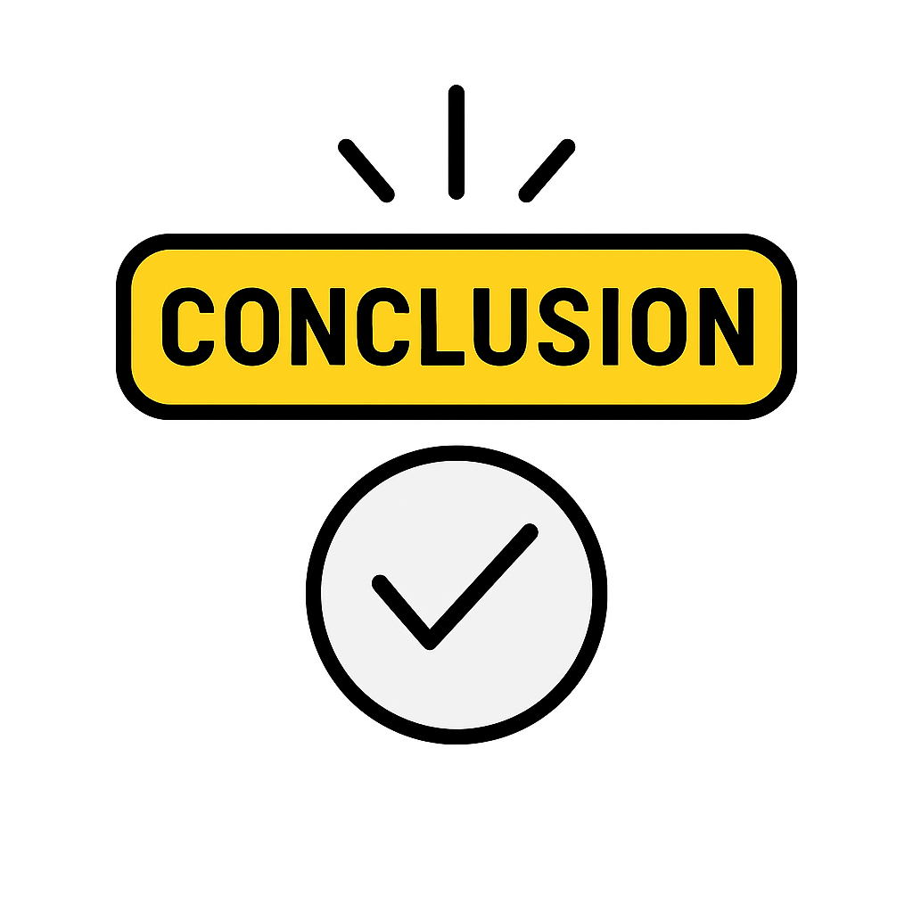
CAN MONEY BUY HAPPINESS?
Janda Hejhal
WEALTH AND SECURITY
STATISTICS
CONSUMER CULTURE
OVERWORKING
MONEY IS NOT ENOUGH
CONCLUSION

Slide 7
CAN MONEY BUY HAPPINESS?
Janda Hejhal
WEALTH AND SECURITY
STATISTICS
CONSUMER CULTURE
OVERWORKING
MONEY IS NOT ENOUGH
CONCLUSION
DO YOU THINK THAT MONEY CAN BUY HAPPINESS?
AT WHAT POINT IN YOUR LIFE DID MONEY MAKE YOU THE HAPPIEST?

Slide 8
WEALTH AND SECURITY
STATISTICS
CONSUMER CULTURE
CAN MONEY BUY HAPPINESS?
Janda Hejhal
OVERWORKING
MONEY IS NOT ENOUGH
CONCLUSION
DO YOU THINK THAT MONEY CAN BUY HAPPINESS?
AT WHAT POINT IN YOUR LIFE DID MONEY MAKE YOU THE HAPPIEST?

